Slide 1
Computer Science
Mr. Eddie

Slide 2
Agenda

Slide 3

Agenda
Do Now
Exit Ticket

Slide 4
Do Now
Answer the following questions:

Slide 5
Unit 1
Using Online Search Tools to Locate & Evaluate Information Pt. 2

Slide 6

Objectives

Slide 7
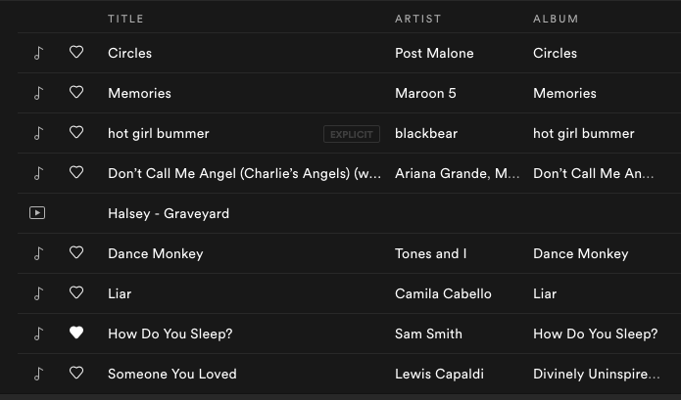

Slide 8
Exit Ticket

